Slide 1



بسم الله الرحمن الرحيم
Intro to compression

Slide 2
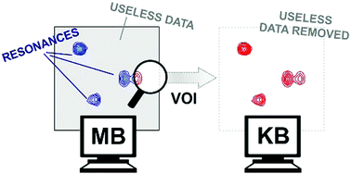
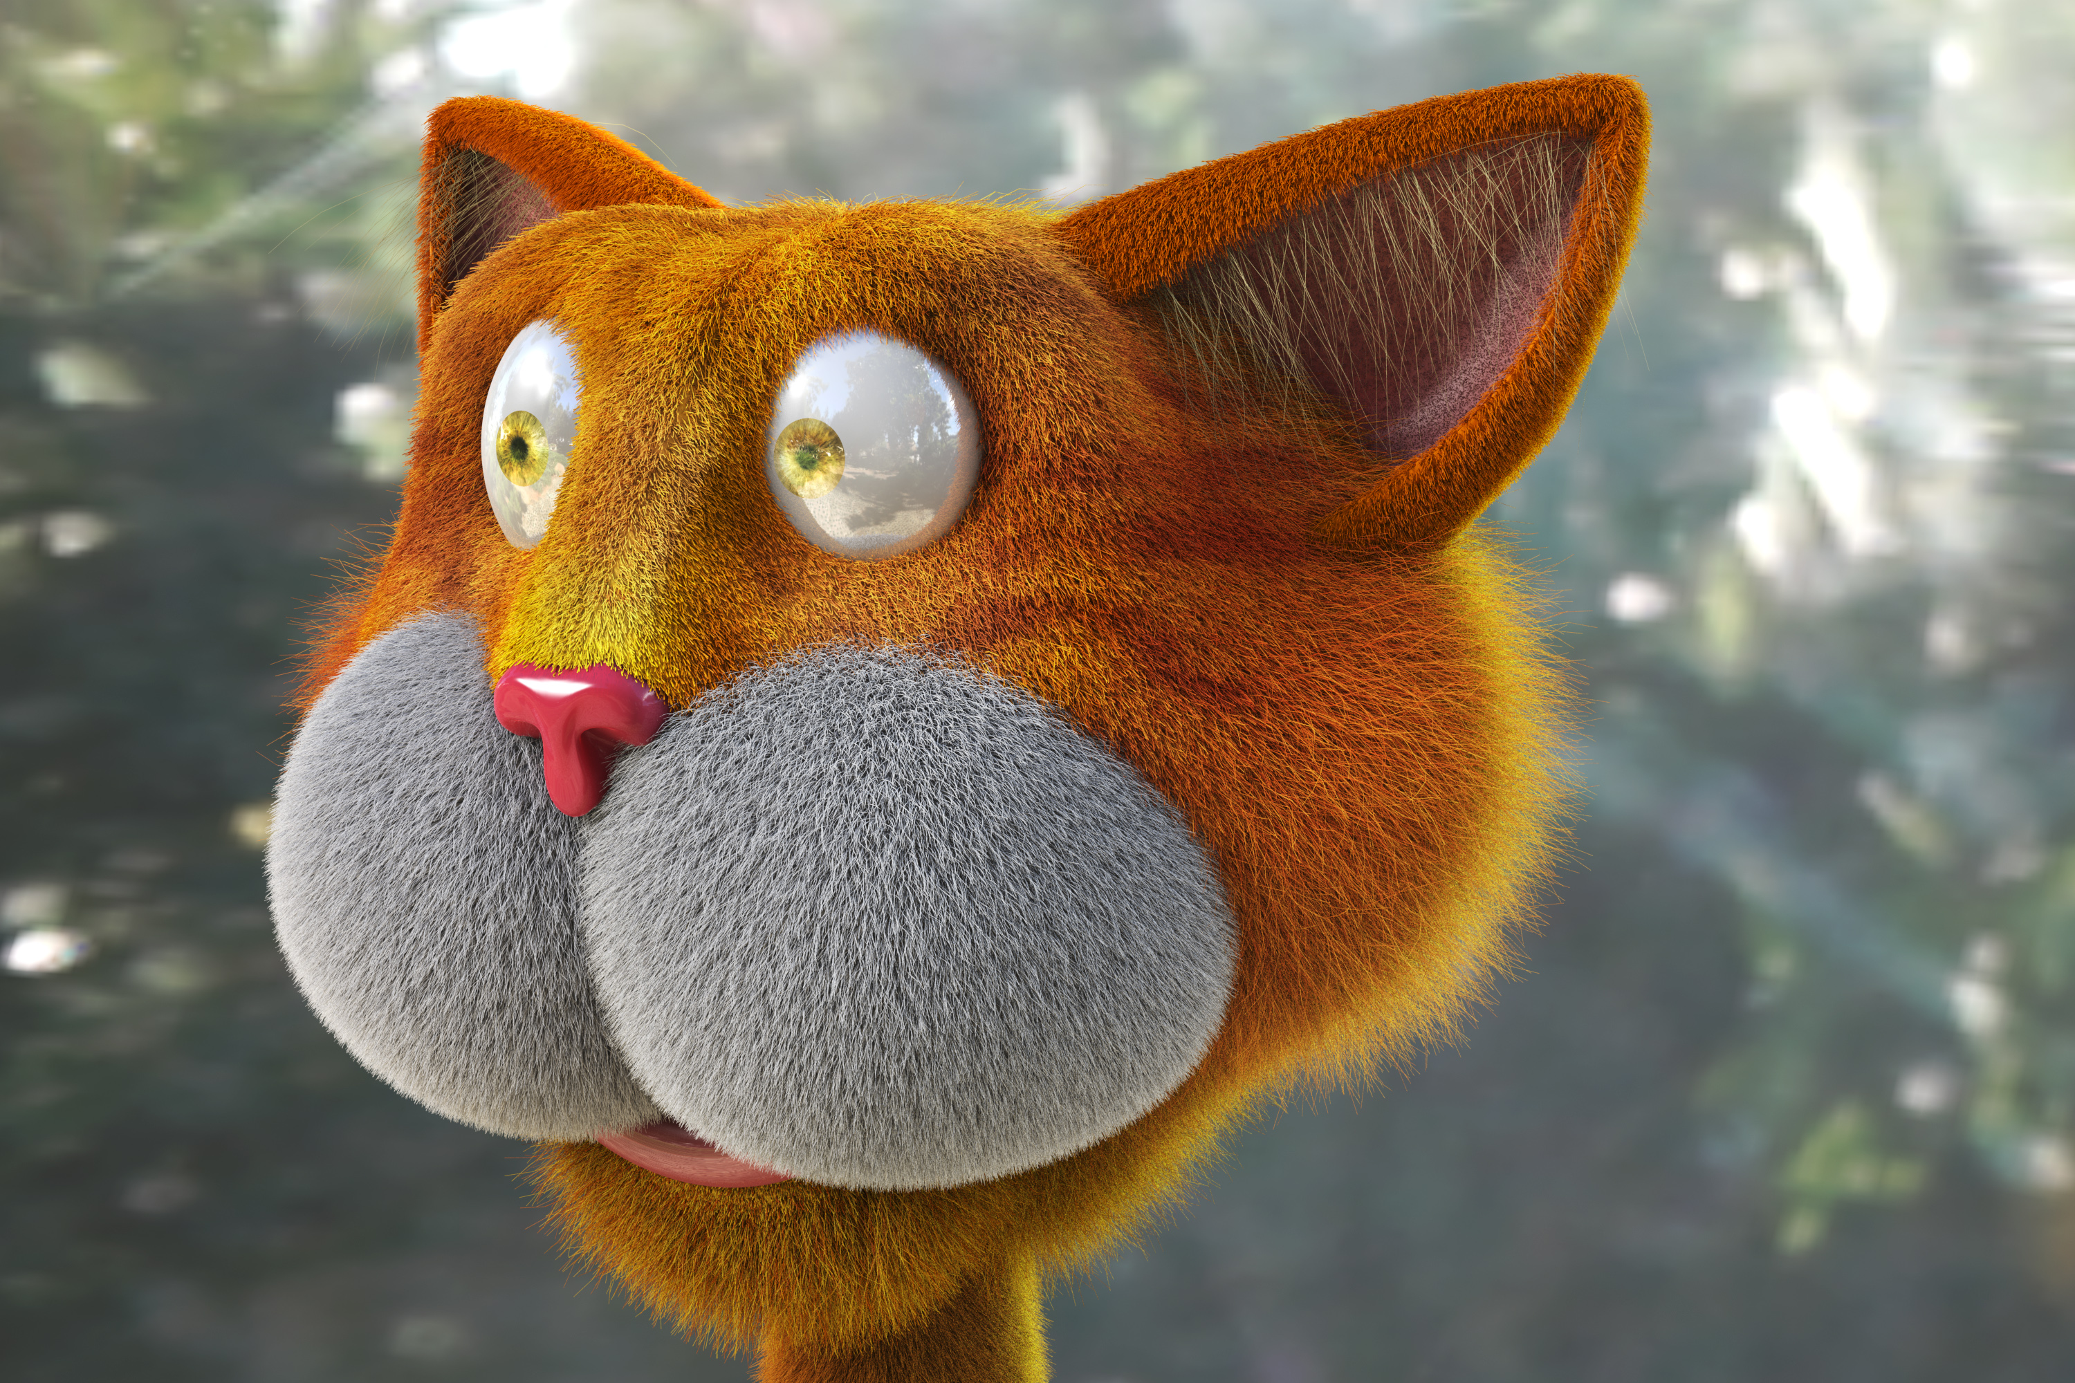
SNR (Signal to Noise Ratio)
What is your name ?
?
Why you wanna it , I say to you : you are not my father to ask me my name
Bla bla bla bla bla my name is Ahmed , so you find it and this can make you happy so on , bla bla bla bla bla bla ………………..
Data
Ahmed is the signal
SNR= 1:500
So -> signal = Data - Noise
With compression I can decrease our words to send it over channel
then signal can be Detected easy

Slide 3
Run Length Encoding
4R,3Y,8G,2P,8K
RRRRYYYGGGGGGGG
PPKKKKKKKK

Slide 4
Differential coding
30,40,-45,20,30
00,00,30,-20,00
20,-10,-06,-10,00
45,-45,20,-20,00
20,00,00,00,00

Slide 5
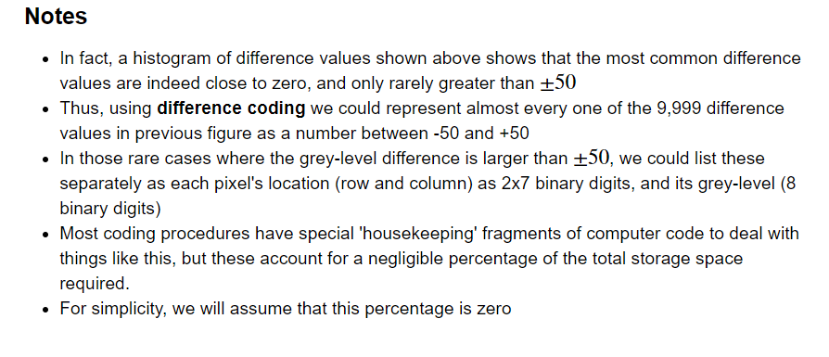
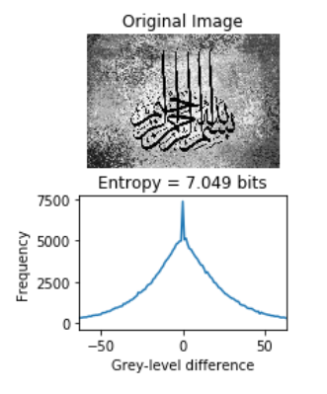

Slide 6
